Slide 1
A Leadership Resource for Patient and Family Engagement Strategies
May 2014

Slide 2
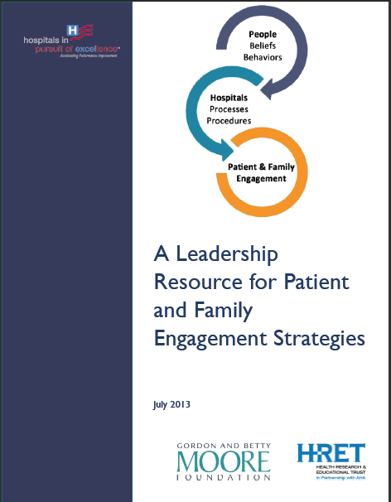
A Leadership Resource for Patient and Family Engagement Strategies
This resource gives hospital and health system leaders concrete, practical steps grounded on evidence-based research to improve patient and family engagement in their organizations by:
Assessing how well the organization is doing
Identifying processes and systems to support patient engagement
Ensuring staff obtain training for effectively using these systems and processes
Intervening to overcome specific obstacles that may emerge
Monitoring progress toward achieving patient and family engagement goals

Slide 3
Directly Impacts Your Hospital

Slide 4
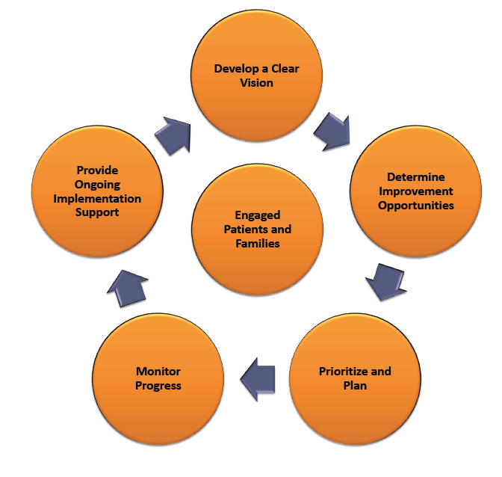
Leadership Action Steps

Slide 5
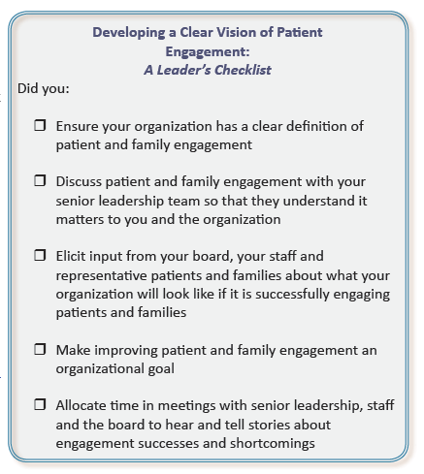
Clear Vision of Patient Engagement

Slide 6
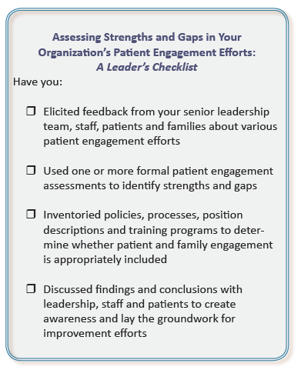
Determine Improvement Opportunities

Slide 7
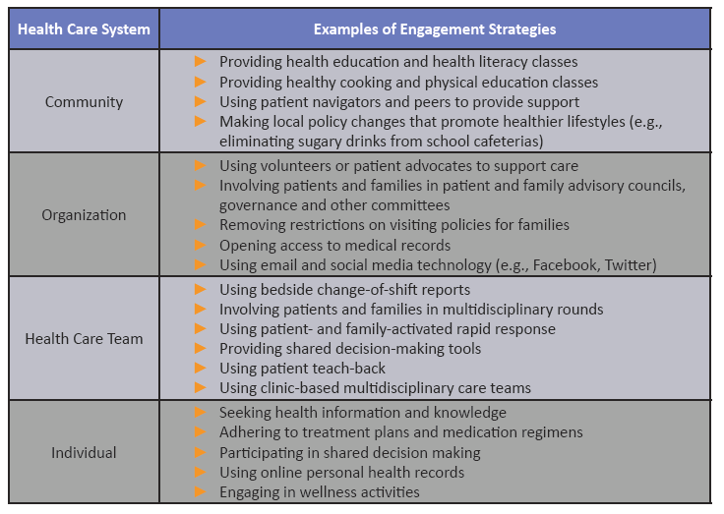
Prioritize and Plan

Slide 8
Implementation

Slide 9
Monitor Progress

Slide 10
Provide Ongoing Implementation Support
With hundreds of journals, dozens of conferences, and scores of white papers and other tools, it is impossible for you or most of your staff to remain fully informed about the growing body of information related to patient and family engagement. Several resources do an exceptional job of summarizing the literature and offering practical guidance to hospitals seeking to fully engage with patients and their families.

Slide 11
About this resource
This Resource was produced by the Health Research & Educational Trust using grant funding provided by the Gordon and Betty Moore Foundation as a part of their Patient Care Program. The Gordon and Betty Moore Foundation, established in 2000, seeks to advance environmental conservation, scientific research and patient care. The goal of the Foundation’s Patient Care Program is to create, in collaboration with others, a fundamentally better healthcare approach that improves quality and safety, reduces costs and ensures dignity and respect to both patients and those who serve them. For more information, please visit www.moore.org.

Slide 12
Copy Right
Resources: For information related to patient and family engagement, visit www.hpoe.org.
Suggested Citation: A Leadership Resource for Patient and Family Engagement Strategies. Health Research & Educational Trust, Chicago: July 2013. Accessed at www.hpoe.org
Contact: hpoe@aha.org (877) 243-0027
Accessible at: www.hpoe.org/Patient-family-engagement
© 2013 Health Research & Educational Trust. All rights reserved. All materials contained in this publication are available to anyone for download on www.hpoe.org for personal, noncommercial use only. No part of this publication may be reproduced and distributed in any form without permission of the publisher, or in the case of third party materials, the owner of that content, except in the case of brief quotations followed by the above suggested citation. To request permission to reproduce any of these materials, please email hpoe@aha.org.

